Slide 1

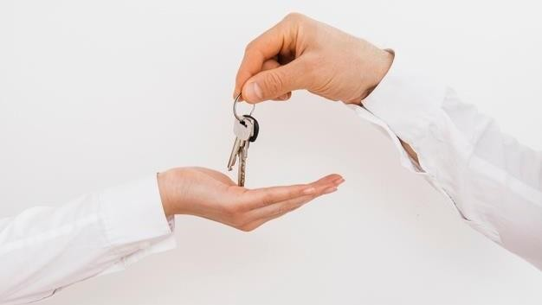
BrokersBunch
1
Group code : 23
1
Khadija Nadiadi (17BCA075) Nayshree Pachori (17BCA103) Nishant Jain (17BCA138)
Internal Guide : Miss Nithya Nadar Mam External Guide : Mr Abhishek shah

Slide 2
INDEX
2
1. Company Profile
1.1 About Company
2. About Project
3. Requirement Gathering
4. Existing System
5. Proposed System
5.1 Admin
5.2 Broker
5.3 Client
Tools And Technology
DFDs
7.1 Context Level
7.2 Level 1
7.3 Level 2
7.3.1 Login(2.0)
7.3.2 Broker(2.1)
7.3.3 Property(2.2)
7.3.4 Appointment(2.3)
8. Data Dictionary
9. ERD Diagram

Slide 3

Company Profile
3
⮚ Company name:- Hauper Technologies.
⮚ Company address :- 501, Shivalik Shilp, Near Iscon Circle, S.G highway, Ahmedabad
⮚ Contact number:- +919978707853
TO INDEX

Slide 4
About Company
4
Hauper technologies is a web design and development company established and located in India.
It was founded to address the core problem in the IT industry of lack of passion about creating products.
They convert ideas to realities. We give insights and advice about
the product itself.
They are always in quest of finding people with whom we can build a product that has utility.
The company is always ready to provide its Customers with original design ideas, robust and scalable applications, dedicated technical assistance and support.
TO INDEX

Slide 5
About Project
5
This web application provides a common platform for broker and client to sale or buy property.
The client can search for property.
If found some reliable property s/he can set appointment with the broker for visiting property.
If interested in buying/selling they can send or recieve messages .
Client need to pay brokerage commission through platform if wants to buy property.
TO INDEX

Slide 6
Requirement Gathering
6
We referred to some of existing system they work for both broker and owner of property .
In order to that we talked with some of the people as well as broker around us and
thought of creating a platform for broker’s community.
This web application will reduce the work of brokers and help them grow their business.
Broker can list the property details.
Client can search for the required property easily using several filters.
Client can book appointment for the properties in which they are interested.
If they have further queries, they can solve it through messaging.
TO INDEX

Slide 7
Existing System
7
Currently broker and owner needs to register their property on the website, so both the parties share same platform.
So buyer will mostly go for the property which is registered by the owner as it has no brokerage commission.
There is limited scope for the development of broker’s business.
There is no option for appointment to visit the property.
TO INDEX

Slide 8
Proposed System Entities (Actors)
8
Admin
Broker
Client
TO INDEX

Slide 9
ADMIN
9
Register:
The Admin will register his account by entering the username, email address and password.
Login:
The Admin will login into his account by entering the username and password.
Managing database:
The Admin will verify and delete or add broker details.
Admin will check the status of the properties and perform the required action.
Admin will mange the feedbacks provided by the broker and add some of them to testimonials
section on homepage.
Admin can view payment details.
TO INDEX

Slide 10
BROKER
10
Login/Register:
Broker will login/register on website with user id and password.
They can login using other platform such as google, facebook etc.
They can also login using their email id and password.
Listing the property:
Broker will collect all the details provided by his client in order to sell a property.
Broker will upload details of the property such as:
Images of property
Type of property
Number of floors.
Dimensions.
Location.
Selling Price of the Property.
TO INDEX

Slide 11
11
Fixing Appointment:
Broker will receive appointment request from client.
If interested he can accept the request.
If interested but not able to go on the time given by broker then s/he can reschedule appointment.
If not interested then can delete the appointment request.
Messaging:
Broker can send or receive messages for the deal, if client have some queries .
Payments:
Broker will receive his commission through the platform.
TO INDEX

Slide 12
CLIENT
12
Login/register:
Client will login/register on website with user id and password.
They can login using other platform such as google, facebook etc.
They can also login using their email id and password.
Searching property:
Client will search for property .
Client can apply the filters according their requirement.
Fixing Appointment:
If client finds appropriate property then they can schedule appointment.
If broker accepts they can visit the property.
TO INDEX

Slide 13
13
Messaging:
If Client has any queries, then they can solve it through messages.
Payments:
If client interested in any property, then they need to pay the brokerage commission through platform.
TO INDEX

Slide 14







TOOLS AND TECHNOLOGY USED
14
⮚ Front End :-
PHP
Javascript CSS
HTML
Jquery
MySQL XAMPP
MS Office 2016, draw.io
Back End :-
Server:-
⮚Other Tools :-
TO INDEX

Slide 15
15
DFD (Data Flow Diagram)
Context Level
TO INDEX

Slide 16

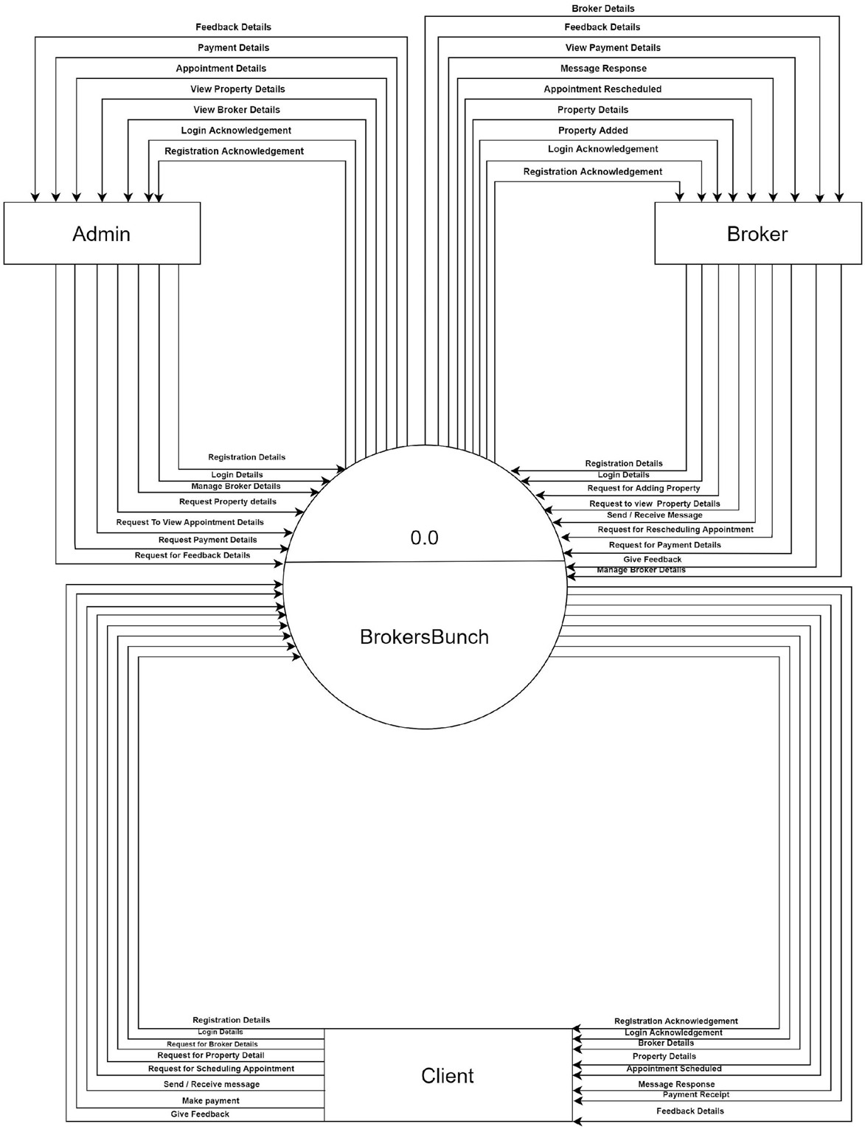
16
16
TO INDEX

Slide 17
Level 1
17
TO INDEX

Slide 18
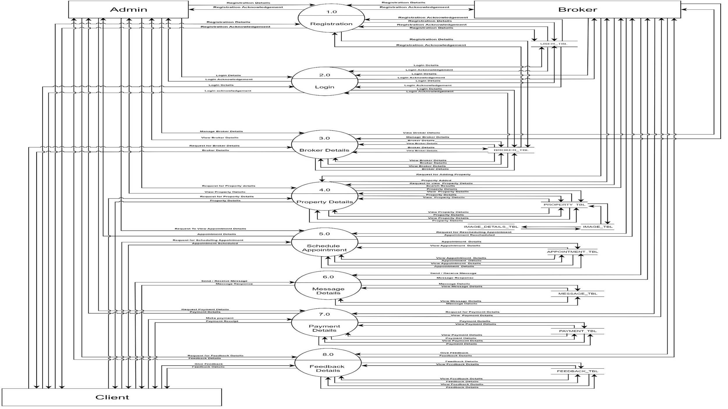
18
18
TO INDEX

Slide 19
19
Level 2
2.0 Login
TO INDEX

Slide 20
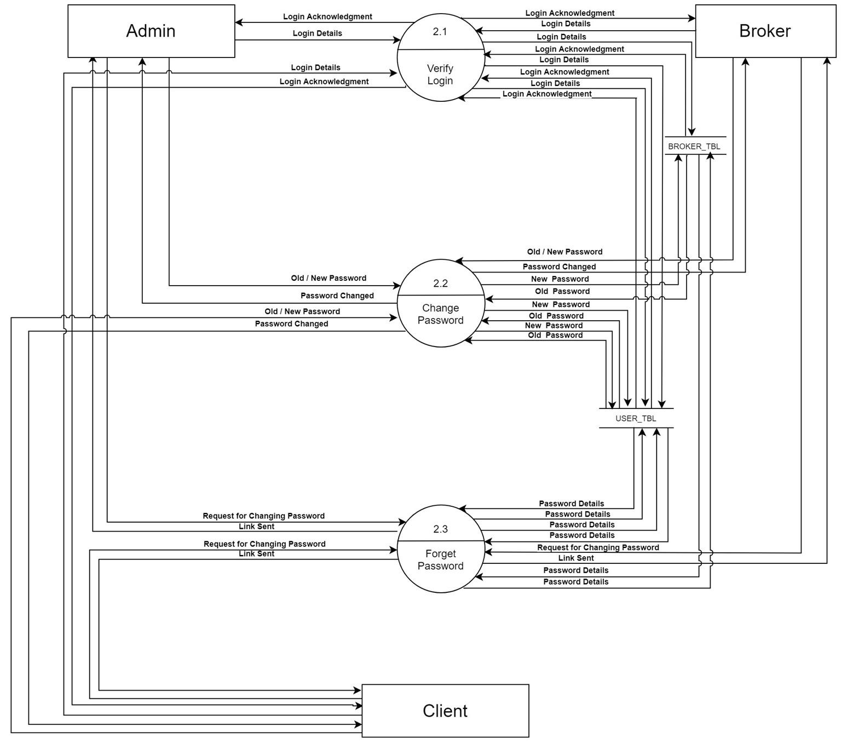
TO INDEX

Slide 21
Level 2 3.0 Broker
21
TO INDEX

Slide 22
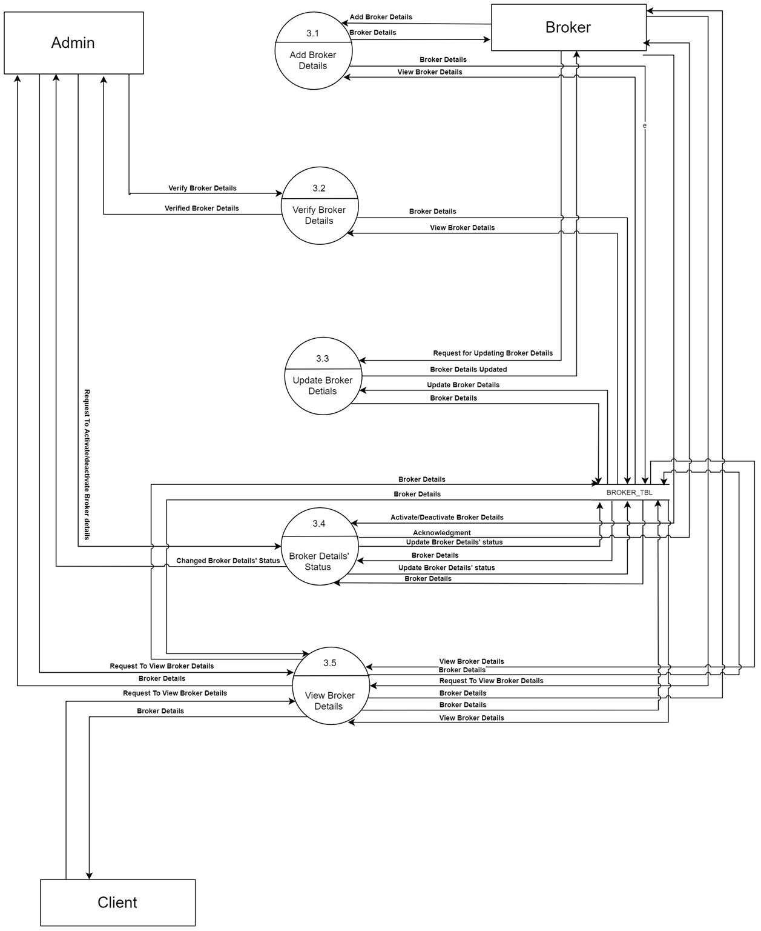
22
TO INDEX

Slide 23
Level 2 4.0 Property
23
TO INDEX

Slide 24
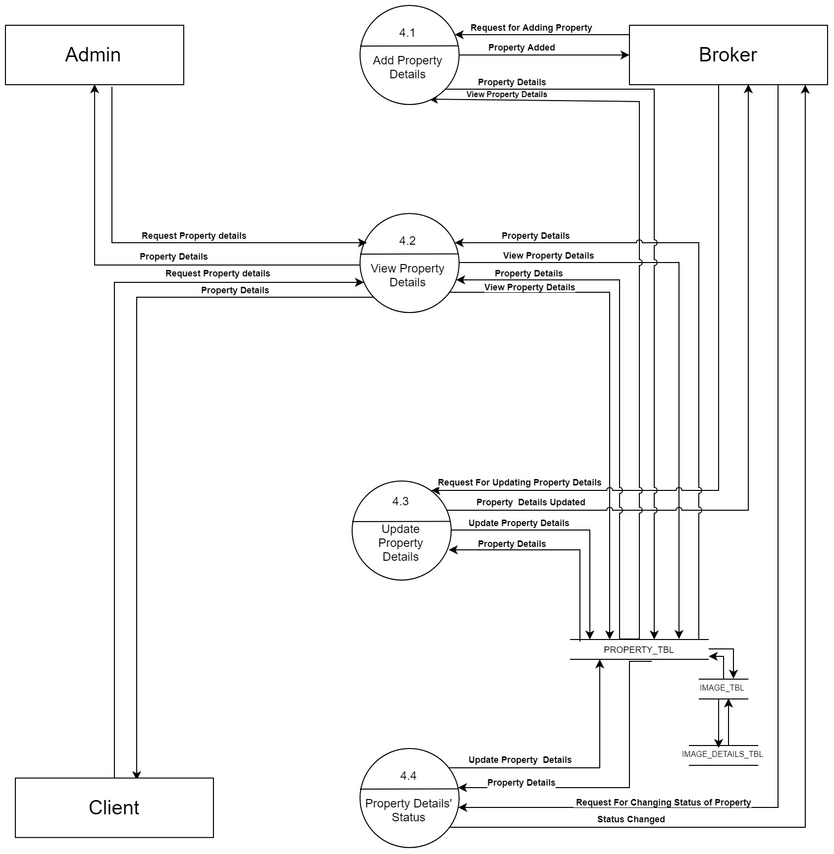
24
TO INDEX

Slide 25
Level 2 5.0 Appointment
25
TO INDEX

Slide 26
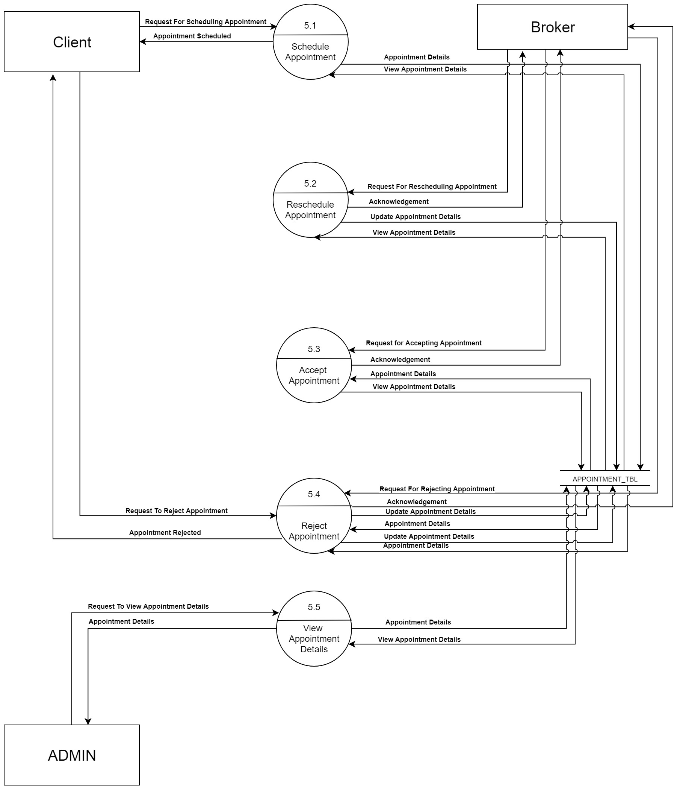
26
TO INDEX

Slide 27
DATA DICTIONARY 1. USER_TBL 2. BROKER_TBL 3. PROPERTY_TBL 4. IMAGE_DETAILS_TBL 5. IMAGE_TBL 6. PROPERTY_TYPE_TBL 7. FLAT_TBL 8. PLOT_TBL 9. STATE_TBL 10. CITY_TBL 11. AREA_TBL 12. APPOINTMENT_TBL 13. MESSAGE_TBL 14. PAYMENT_TBL 15. FEEDBACK_TBL 16. PROPERTY RELATION TABLE
27
TO INDEX

Slide 28

28
USER_TBL: It stores the details of user on the basis of their type, Admin or Client.
Field_Name | Data_Type | Field_Size | Constraint | Description
USER_ID | VARCHAR | 10 | PRIMARY KEY | It stores the USER_ID of the Admin or Client
AREA_ID | VARCHAR | 10 | FOREIGN KEY | It stores the AREA_ID
USER_TYPE | VARCHAR | 20 | CHECK | Stores the USER_TYPE
FIRST_NAME | VARCHAR | 20 | NOT NULL | It stores the FIRST_NAME
LAST_NAME | VARCHAR | 20 | NOT NULL | It stores the LAST_NAME
GENDER | BIT | - | CHECK | GENDER of the Admin
ADDRESS | VARCHAR | 30 | NOT NULL | ADDRESS of the Admin
EMAIL_ID | VARCHAR | 20 | NOT NULL | EMAIL_ID of the Admin
U_PASSWORD | VARCHAR | 10 | NOT NULL | Stores the PASSWORD of Admin
MOBILE_NO | NUMBER | 10 | NOT NULL | MOBILE_NO of the Admin
TO DD'S INDEX

Slide 29
BROKER_TBL: It stores the details of broker.
29
Field_Name | Data_Type | Field_Size | Constraint | Description
BROKER_ID | VARCHAR | 10 | PRIMARY KEY | It stores the BROKER_ID
AREA_ID | VARCHAR | 10 | FOREIGN KEY | It stores the AREA_ID
FIRST_NAME | VARCHAR | 20 | NOT NULL | It stores the FIRST_NAME
LAST_NAME | VARCHAR | 20 | NOT NULL | It stores the LAST_NAME
GENDER | BIT | - | NOT NULL | GENDER of the Broker
ADDRESS | VARCHAR | 30 | NOT NULL | ADDRESS of the Broker
EMAIL_ID | VARCHAR | 20 | NOT NULL | EMAIL_ID of the Broker
B_PASSWORD | VARCHAR | 8 | NOT NULL | Stores the PASSWORD of Broker
MOBILE_NO | NUMBER | 10 | NOT NULL | MOBILE_NO of the Broker
REG_CER_IMG | VARCHAR | 30 | NOT NULL | It stores the path of the image
STATUS | VARCHAR | 10 | NOT NULL | Stores the STATUS of the Broker like ACTIVE / INACTIVE
PAN_CARD_NO | VARCHAR | 10 | NOT NULL | Stores the PAN_CARD_NO of Broker
TO DD'S INDEX

Slide 30
30
PROPERTY_TBL: It stores the details of property.
Field_Name | Data_Type | Field_Size | Constraint | Description
PROPERTY_ID | VARCHAR | 10 | PRIMARY KEY | It stores the PROPERTY_ID
IMAGE_DET_ID | VARCHAR | 10 | FOREIGN KEY | It stores the IMAGE_ID
AREA_ID | VARCHAR | 10 | FOREIGN KEY | It stores the AREA_ID
PROPERTY_TYPE_ID | VARCHAR | 10 | FOREIGN KEY | Stores the PROPERTY_TYPE_ID of the Property
SPECIALITY | VARCHAR | 50 | NOT NULL | Stores the SPECIALTY of the Property like distance between property location and public places
PRICE | INTEGER | 20 | NOT NULL | Total AMOUNT of the Property in Rupees
TO DD'S INDEX

Slide 31
IMAGE_DETAILS_TBL : It stores the id of images in order to retrieve them according to property.
31
Field_Name | Data_Type | Field_Size | Constraint | Description
IMAGE_DET_ID | VARCHAR | 10 | PRIMARY KEY | It stores the IMAGE_DET_ID of the Image
IMAGE_ID | VARCHAR | 10 | FOREIGN KEY | It stores the IMAGE_ID
TO DD'S INDEX

Slide 32
32
IMAGE_TBL : It stores the number of images of the property.
Field_Name | Data_Type | Field_Size | Constraint | Description
IMAGE_ID | VARCHAR | 10 | PRIMARY KEY | It stores the IMAGE_ID
PROPERTY_ID | VARCHAR | 10 | FOREIGN KEY | It stores the PROPERTY_ID
BROKER_ID | VARCHAR | 10 | FOREIGN KEY | It stores the BROKER_ID of the Broker
IMAGE_DET_ID | VARCHAR | 10 | FOREIGN KEY | It stores the IMAGE_DET_ID of the Image
PROPERTY_IMG | VARCHAR | 10 | NOT NULL | It stores the path of the image
TO DD'S INDEX

Slide 33
33
PROPERTY_TYPE_TBL : it stores the id of type of property.
Field_Name | Data_Type | Field_Size | Constraint | Description
PROPERTY_TYPE_ID | VARCHAR | 10 | PRIMARY KEY | It stores the PROPERTY_TYPE_ID of the property
FLAT_ID | VARCHAR | 10 | FOREIGN KEY | It stores the FLAT_ID
PLOT_ID | VARCHAR | 10 | FOREIGN KEY | It stores the PLOT_ID
TO DD'S INDEX

Slide 34
FLAT_TBL: It stores the details of flat type of property.
34
Field_Name | Data_Type | Field_Size | Constraint | Description
FLAT_ID | VARCHAR | 10 | PRIMARY KEY | It stores the FLAT_ID
FLOOR_NO | NUMBER | 3 | NOT NULL | It stores the number of FLOOR of the Property
TOTAL_FLOORS | NUMBER | 3 | NOT NULL | It store the total numbers of FLOORS of the property
ROOMS | NUMBER | 2 | NOT NULL | It stores the numbers of ROOMS of the Property
DIMENSIONS | NUMBER | 4 | NOT NULL | It store the DIMENSION of the property in sq. ft.
BALCONY | NUMBER | 2 | NOT NULL | It store the total numbers of BALCONY of the property
FURNISHED | VARCHAR | 20 | CHECK | it shows whether the house is furnished, unfurnished, semi furnished
ESTD | NUMBER | 4 | NOT NULL | It stores the Property’s built year
PARKING | BIT | - | NOT NULL | It shows whether PARKING is available or not
TO DD'S INDEX

Slide 35
35
PLOT_TBL: It stores the details of plot type of property.
Field_Name | Data_Type | Field_Size | Constraint | Description
PLOT_ID | VARCHAR | 10 | PRIMARY KEY | It stores the PLOT_ID
PROPERTY_TYPE_ID | VARCHAR | 10 | FOREIGN KEY | It stores the PROPERTY_ID
DIMENSION | VARCHAR | 4 | NOT NULL | It stores the DIMENSION of the Property in sq ft
NO_OF_OPEN_SIDE | NUMBER | 3 | NOT NULL | It stores the number of open sides of the Property
ROAD_WIDTH | NUMBER | 5 | NOT NULL | It stores the width of the road facing plot
TO DD'S INDEX

Slide 36
36
STATE_TBL : It stores the State of property.
Field_Name | Data_Type | Field_Size | Constraint | Description
STATE_ID | VARCHAR | 10 | PRIMARY KEY | It stores the STATE_ID
STATE_NAME | VARCHAR | 20 | NOT NULL | It stores the STATE_NAME
CITY_TBL: It stores the city of property.
Field_Name | Data_Type | Field_Size | Constraint | Description
CITY_ID | VARCHAR | 10 | PRIMARY KEY | It stores the CITY_ID
CITY_NAME | VARCHAR | 20 | NOT NULL | It stores the CITY_NAME
STATE_ID | VARCHAR | 10 | FOREIGN KEY | It stores the STATE_ID
TO DD'S INDEX

Slide 37
37
AREA_TBL : It stores the area of property.
Field_Name | Data_Type | Field_Size | Constraint | Description
AREA_ID | VARCHAR | 10 | PRIMARY KEY | It stores the AREA_ID
AREA_NAME | VARCHAR | 20 | NOT NULL | It stores the AREA_NAME
CITY_ID | VARCHAR | 10 | FOREIGN KEY | It stores the CITY_ID
TO DD'S INDEX

Slide 38
38
APPOINTMENT_TBL : It stores the details of Appointment of property.
Field_Name | Data_Type | Field_Size | Constraint | Description
APPOINTMENT_ID | VARCHAR | 10 | PRIMARY KEY | It stores the APPOINTMENT_ID
USER_ID | VARCHAR | 10 | FOREIGN KEY | It stores the USER_ID of the Admin or Client
BROKER_ID | VARCHAR | 10 | FOREIGN KEY | It stores the BROKER_ID
DATE | DATETIME | 10 | NOT NULL | It stores the DATE of the Appointment
TIME | DATETIME | 5 | NOT NULL | It stores the TIME of Appointment
STATUS | VARCHAR | 10 | NOT NULL | It Stores the STATUS of the Appointment like Accept / Delete / Reschedule
PROPERTY_ID | VARCHAR | 10 | PRIMARY KEY | It stores the PROPERTY_ID
TO DD'S INDEX

Slide 39
39
MESSAGE_TBL: it stores the details of messages between broker and client.
Field_Name | Data_Type | Field_Size | Constraint | Description
MESSAGE_ID | VARCHAR | 10 | PRIMARY KEY | It stores the MESSAGE_ID
USER_ID | VARCHAR | 10 | FOREIGN KEY | It stores the USER_ID of the Admin or Client
BROKER_ID | VARCHAR | 10 | FOREIGN KEY | It stores the BROKER_ID
TIME | DATETIME | 5 | NOT NULL | It stores the TIME of Message sent/received
TO DD'S INDEX

Slide 40
40
PAYMENT_TBL : it stores the payment details of broker’s commission.
Field_Name | Data_Type | Field_Size | Constraint | Description
PAYMENT_ID | VARCHAR | 10 | PRIMARY KEY | It stores the PAYMENT_ID
USER_ID | VARCHAR | 10 | FOREIGN KEY | It stores the USER_ID of the Admin or Client
BROKER_ID | VARCHAR | 10 | FOREIGN KEY | It stores the BROKER_ID
PAYMENT_AMT | INTEGER | 10 | NOT NULL | It stores the Commission of Broker in form of PAYMENT_AMT
PAYMENT_DATE | DATETIME | 10 | NOT NULL | It stores the PAYMENT_DATE
PAYMENT_STATUS | VARCHAR | 10 | CHECK | It shows the PAYMENT_STATUS
TO DD'S INDEX

Slide 41
41
FEEDBACK_TBL : It stores the feedback details .
Field_Name | Data_Type | Field_Size | Constraint | Description
FEEDBACK_ID | VARCHAR | 10 | PRIMARY KEY | It stores the FEEDBACK_ID
USER_ID | VARCHAR | 10 | FOREIGN KEY | It stores the USER_ID of the Admin or Client
BROKER_ID | VARCHAR | 10 | FOREIGN KEY | It stores the BROKER_ID
FEEDBACK_MSG | VARCHAR | 120 | NOT NULL | It stores the FEEDBACK_MSG of client and broker
TO DD'S INDEX

Slide 42
42
PROP_RELATION_TBL : It stores the IDs of User, Broker, Property
Field_Name | Data_Type | Field_Size | Constraint | Description
USER_ID | VARCHAR | 10 | FOREIGN KEY | It stores the USER_ID of the Admin or Client
BROKER_ID | VARCHAR | 10 | FOREIGN KEY | It stores the BROKER_ID
PEOPERTY_ID | VARCHAR | 10 | FOREIGN KEY | It stores the PROPERTY_ID
TO DD'S INDEX

Slide 43
43
ENTITY RELATIONSHIP DIAGRAM
(ERD)
TO INDEX

Slide 44
TO INDEX

Slide 45


45

